Slide 1
Computer Principles for Programmers
History and Types of Computers and Programming

Slide 2
Quiz

Slide 3
News of the Week

Slide 4
Agenda
Lecture:
Milestones of Computer History
What do we mean by Hardware?
What do we mean by Software?
An overview of Programming
Low-Level vs High-Level Programming
Notes:
Programming Overview:
What do we mean by Algorithm, Code, and Programming?
Short history of Programming Languages.
What do we mean by Low-Level Programming and High-Level Programming
Types of Programming Languages (Compiled, Interpreted, Scripting, Embeddable, etc.)
Discussed in Week 6
What do we mean by an Application Software? How does it work along with a System Software?
What do we mean by a System Software/Operating System?

Slide 5
Agenda (Cont’d)
Activities:
Four options on hardware and software concepts.
Do any two.

Slide 6
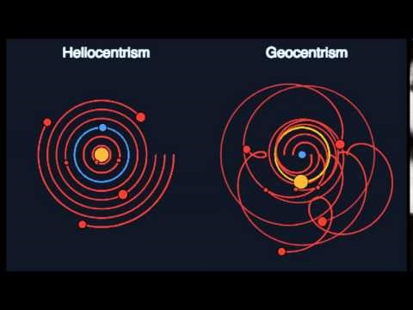
History of Computing
A new thing is invented:
“But what ... is it good for?”
Engineer at the Advanced Computing Systems Division of IBM commenting on the microchip in 1968.
The new thing is made useful:
“Discovery consists of seeing what everybody has seen and thinking what nobody has thought.”
Albert Szent-Gyorgyi (Nobel Prize for Medicine, 1937)
Notes:
“We see only what we know.” Geothe 1749-1832. German literature & science author, statesman
It's not, "I'll believe it when I see it". We don’t believe what we see, we see what we believe.
500 years ago, people saw the sun come up in the east and set in the west and, at night, the movement of the moon, stars and planets and believed that the earth was the center of the universe. But now, we believe the earth goes around the sun and that there is no center of the universe, and the sky looks…exactly the same. The sun still rises in the east and sets in the west but everything is different because we believe differently even though we see the same thing.
Heliocentrism vs Geocentrism, an 11 second animation (conceptually if not astronomically, accurate)
https://www.youtube.com/watch?v=waexG16WZrE
https://www.wired.com/2014/04/how-do-we-know-the-earth-orbits-the-sun/
The development of computer hardware, software, and much else, proceeds like this.

Slide 7
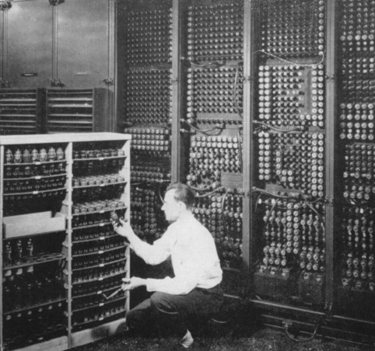
Early Computers
Notes:
Counting devices like the abacus have been around for about 5,000 years. Ten fingers and toes have been around even longer.
Calculating devices were first invented in the 17th C.
For many of us,
hardware is having the latest smartphone,
hardware is all fast enough, it’s the network that is slow.
What follows is just a little perspective on computer history illustrated by major milestones.
For more info, see http://io9.gizmodo.com/the-history-of-early-computing-machines-from-ancient-t-549202742 and a hundred other websites for more info.
https://www.autodesk.com/products/eagle/blog/computers-around-century-ago/

Slide 8
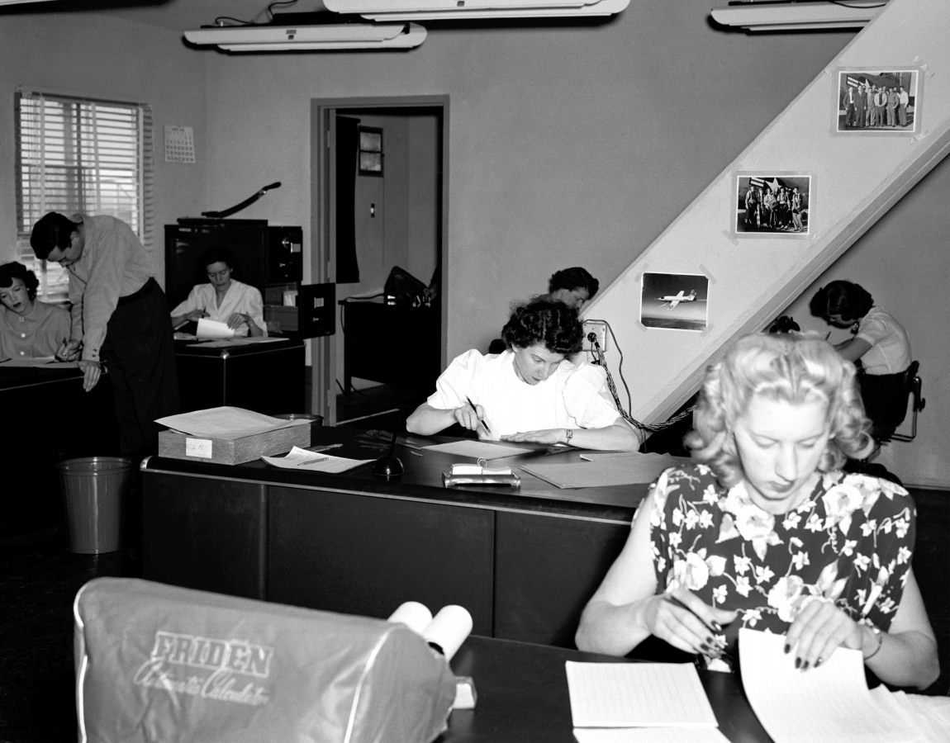
NACA (NASA) High Speed Flight Station Computer Room (1949)
Notes:
Do you see any computers?
No? There are six of them…all with nice hairdos. The guy is likely the supervisor handing out assignments because he is not a good enough mathematician.
From the early 17th C until the mid 20th C, a computer was “one who computes”: a person who applied mathematical formulae procedurally to solve complex problems.
They used calculators (“Friden” in foreground) but people did the computing. Those people were usually women. Go see the 2016 movie Hidden Figures.
https://en.wikipedia.org/wiki/Human_computer

Slide 9
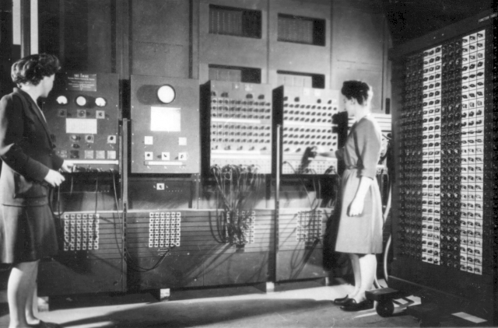
ENIAC (Electronic Numerical Integrator And Computer) 1946
Notes:
ENIAC is considered the grandfather of computers, the world’s first all-digital, Turing-complete, general-purpose computer. It filled a 20-foot by 40-foot room, had 18,000 vacuum tubes, 3,000 switches, and weighed 60,000 pounds. ENIAC took 30 seconds to do a differential calculus problem that took a real computer in those days–a math expert with a calculator, usually a woman–20 hours to do. This is partly why "computing" was considered clerical work.
The ENIAC was on the cover of Time magazine with the headline 'Giant Brains.' Today, the same computational power is used in greeting cards that play you a tune. Imagine the reaction if Time magazine had predicted: fifty years in the future, millions of hand-held, self-powered ENIACs will be bought for a few dollars at the corner store, used for 30 seconds and thrown away. No one would have believed you; who could envision a microprocessor after seeing an ENIAC?
Programmers Betty Jennings (left) and Fran Bilas (right) operate the ENIAC's main control panel. Six women mathematicians {Kathleen McNulty Mauchly Antonelli, Jean Jennings Bartik, Frances Snyder Holberton, Marlyn Wescoff Meltzer, Frances Bilas Spence, Ruth Lichterman Teitelbaum}, known as the ENIAC 6, programmed the ENIAC by laboriously setting switches and plugging cables. There was no manual how to use the ENIAC, only blueprints and wiring diagrams. They invented modular programming and subroutines.
Frances Holberton (nee Snyder) later developed the first data sorting algorithm which greatly simplified a common but laborious task, she developed the decision tree for the binary sort function; her sort-merge generator "inspired the first ideas about compilation"; she invented breakpoints for computer debugging. Holberton developed the C-10 instruction set for BINAC said by Grace Hopper to be "the basis for all subsequent programming languages" (Grace also said Holberton "was the best programmer" that she had ever known. Holberton designed control panels that put the numeric keypad next to the keyboard. She was a crucial member of the team developing COBOL, the business programming language and FORTRAN (with Grace Hopper). On her first day of classes at the University of Pennsylvania, Holberton's math professor asked her if she wouldn't be better off at home raising children. She was finally granted an IEEE Computer Pioneer Award in 1997. Jean Bartik did not receive the same award until 2009.
IEEE, pronounced "Eye-triple-E," stands for the Institute of Electrical and Electronics Engineers. It is the world's largest technical professional association.
The ENIAC 6 were not invited to the official announcement party for the ENIAC computer.
Five years later, the ENIAC lead to the UNIVAC in 1951, the first commercial computer for business and government applications. UNIVAC is an acronym for UNIVersal Automatic Computer. Kathleen (Kay) McNulty and Jean Bartik and Betty Holberton were instrumental in the UNIVAC's design and success.
There's much more, see https://vimeo.com/107667129 and http://eniacprogrammers.org/
https://en.wikipedia.org/wiki/ENIAC and https://en.wikipedia.org/wiki/Betty_Holberton
http://www.nytimes.com/2001/12/17/business/frances-e-holberton-84-early-computer-programmer.html
http://fortune.com/2014/09/18/walter-isaacson-the-women-of-eniac/
https://iq.intel.com/how-female-eniac-programmers-pioneered-the-software-industry/
http://hopl.info/showlanguage.prx?exp=5442
http://www.cbi.umn.edu/iterations/norberg.pdf
https://spin.atomicobject.com/2016/07/31/eniac-programmers/
https://www.digitaltrends.com/computing/remembering-eniac-and-the-women-who-programmed-it/
"We had a tube fail about every two days and we could locate the problem within 15 minutes." -- J. Presper Eckert, 1946 (the other ENIAC designer)
I wish I could go two days without some kind of a computer problem or fix anything within 15 minutes.
ENIAC's longest continuous period of operation without a failure was 116 hours (close to five days).
When's the last time your computing device ran that long without a reboot or a problem?

Slide 10
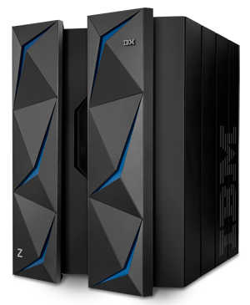
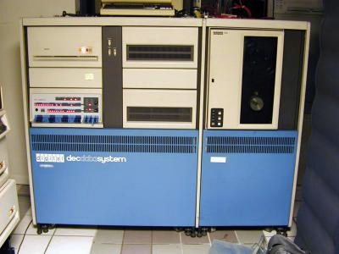
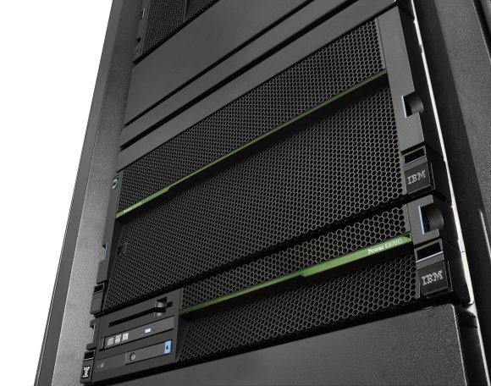
Mainframes, minis, and mid-range.
IBM Power Server
DEC PDP-11/70 1970s 4MB RAM
IBM z14, 32TB RAM (2017) Mainframes run 68% of the world’s production workloads at 6% of total IT costs
Investment protection: backward compatibility with 1960s-era IBM S/360 line
Notes:
Large scale computer architecture was established by the IBM/360 “mainframe” or “big iron” in the 1960’s and continues today. A ‘big iron’ mainframe is called that because the CPU and iron core memory were contained in a frame, the main frame. Current IBM mainframes are known as the Z series where Z stands for zero downtime. Z14 can process 12 billion encrypted transactions per day or ~140,000/second.
A z/OS address space (16 exabytes) is 4 billion times the size of an x86 32-bit 4 gigabyte address space. X86-64 can address 4 petabytes.
https://www.ibm.com/it-infrastructure/z/news
https://www.ibm.com/it-infrastructure/linuxone
https://www.theregister.co.uk/2017/07/17/ibm_latest_mainframe_z14/
http://www.planetmainframe.com/2017/07/new-ibm-z14-secure-flexible-powerful-analytical-ever/
https://www.nanalyze.com/2017/10/ibm-mainframe-computers-today/ Most of world’s money flows through mainframes which are used in banking, insurance, government, and are behind much of the world’s financial markets and global commerce.
IBM mainframes handle:
more than 30 billion transactions a day (8.6 times as many as the 3.5B Google searches daily)
87 percent of all credit card transactions ($8 trillion a year)
29 billion ATM transactions ($5 billion a day)
4 billion passenger flights a year
68% of the world’s production workloads at just 6% of total IT costs
IBM’s z14 mainframe can encrypt data 18X faster than x86 platforms at just 5% of the cost.
Why Mainframes?
Low TOC (Total Cost of Ownership) for Enterprise scale computing.
highly reliable: “six nines” reliable with 99.9999% uptime. IBM z systems average 76 seconds of unplanned per server annual downtime or less (25% of z servers had 52 seconds / year downtime) http://ibmsystemsmag.com/mainframe/business-strategy/competitive-advantage/itic-reliability-survey/ Secure: z14 encrypts every level of the system, then stores everything inside encrypted containers. If the system detects an attack like malware or other intrusion, it has been designed to shut itself down automatically.
Has extensive external input – output facilities. Can support hundreds of thousands of users and millions of connections.
Has multiple peripheral processors to handle slow I/O and cryptography, and the slightly slower control of memory while up to 170 CPUs are busy with computational tasks. i.e. very high performance.
Is compatible with old software. IBM calls it investment protection. If they upgrade your mainframe to make it faster, they will not break your existing software…unlike a lot of other evolving platforms.
In the 1970s, “minicomputers” arrived. They were much more affordable than mainframes and began appearing in small to medium sized businesses to handle their smaller workloads. Various manufacturers created systems running versions of UNIX. The Digital Equipment Corporation’s PCP-11 (Programmed Data Processor) was a landmark machine in the 1970s and cost about 10% of a mainframe. IBM started a “proprietary” line of mid-range computers in the 1980s that continues today achieving five nines reliability < 5.25 minutes of unscheduled downtime per year. Today’s mid-range computers are much larger in capacity than yesterday’s mainframes.
There are and have been other computer manufacturers besides IBM however IBM has been the mainstay of the business computing world primarily because their new machines do not break existing software.
IBM was criticized as “Inferior But Marketable”. IBM was never at the bleeding edge of computing in terms of their commercial offerings. But IBM’s products worked reliably and had the industry’s best support. “Nobody ever got fired for buying IBM.” If you chose IBM and there was a problem, well, it was a reasonable decision and IBM could be trusted to fix it. But if you deviated from the norm and chose something else that didn't work out, people blamed you.
IBM has been on the bleeding edge of R&D for some time. 2016 was the 24th consecutive year that IBM topped the annual list of U.S. patent recipients when IBM inventors received a record 8,088 patents.
IBM Power systems are used by Google to run their search engine.
POWER9-based systems can transfer data up to 9.5 times faster than an Intel-based system (think Linux)
http://ibmsystemsmag.com/blogs/aixchange/march-2018/power9-attracts-a-big-customer/

Slide 11
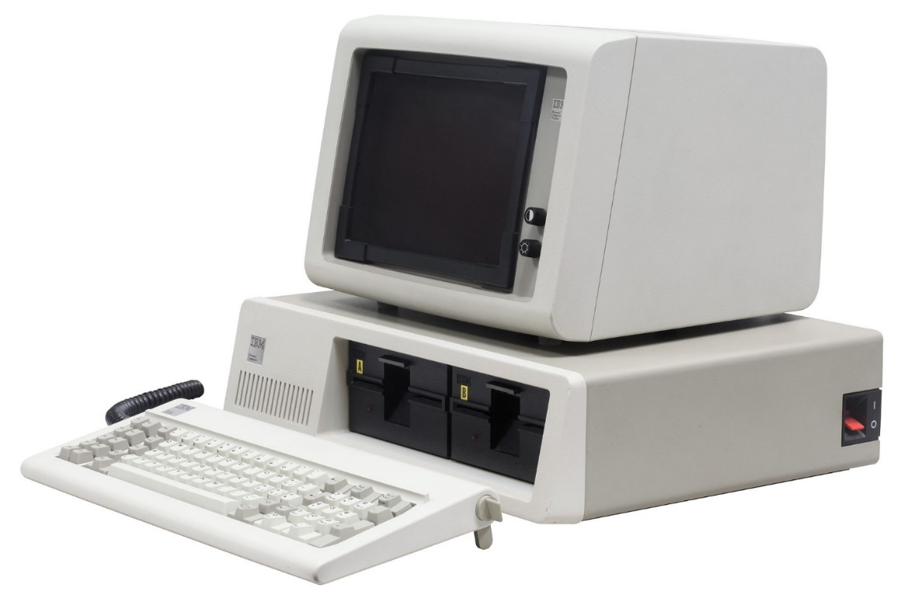
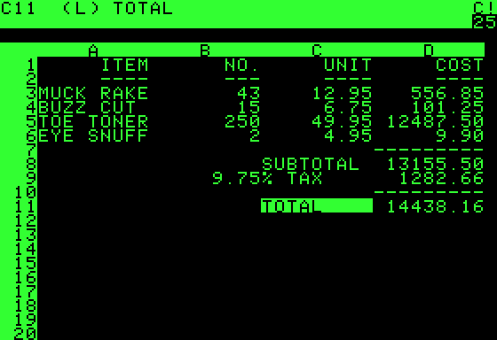
IBM PC, Model 5150, 1981 & VisiCalc
VisiCalc, the first "killer application"
Notes:
Today, personal computing means smartphones and tablets. Personal computing started in the mid 1970’s but became credible in 1978 with VisiCalc running on the Apple II because no other hardware could run the first “killer application”, the VisiCalc spreadsheet program. “VISICALC represented a new idea of a way to use a computer and a new way of thinking about the world. Where conventional programming was thought of as a sequence of steps, this new thing was no longer sequential in effect: When you made a change in one place, all other things changed instantly and automatically.”
— Ted Nelson^{[7]}
On August 12, 1981, IBM introduced its smallest, lowest-priced computer system, the IBM Personal Computer, forever known as the "PC". You can see one in Tim McKenna’s office, DB2095. It cost CDN$6,600 for the full system including the printer. In 2017 dollars, the system would cost $16,666. Then and now, about the price of a sub-compact car. Remember software “investment protection” on the mainframe? The IBM imprimatur extended to the PC. With a number of competing platforms, it was IBM’s acceptance in the business community that helped established the PC as standard platform for personal business computing. That, and the disaster of the Apple III at the same time.
When the IBM PC debuted, Microsoft was the only company that offered operating system, programming language, and application software for the new computer. Bill Gates had convinced IBM to agree that PC-DOS (Disk Operating System) would not be an IBM exclusive and allowed Microsoft to market MS-DOS. This paved the way for the PC clone industry. IBM used commodity hardware components but did create the unique BIOS (Basic Input Output System) yet it was soon reverse engineered. In 1983, Lotus 1-2-3, the spreadsheet/database/graphical charts program, took full advantage of the IBM PC’s hardware capabilities (unlike VisiCalc). The combination of Lotus 1-2-3 and IBM/Lotus compatible machines made it the standard tool of business. Apple almost died as a result. VisiCalc did die but it is fondly remembered.
PCs slowly replaced terminals on people’s desks connected to mainframes and radically changed business IT.
IBM's initial five-year forecast was for just over 250,000 PCs. IBM sold more than 12X as many: 3 million in that time. They thought 80 million PCs would be sold by the end of the century. They missed that forecast too, by more than 500 million or only a factor of 6.
In the last 60 years, computers as we know them, have become continually better, faster, and cheaper. Sure your iPhone 6 has 1,000 times more flops (Floating Point Operations) than a Cray-1 supercomputer from the 1970s but nobody researching high-energy physics today is doing it on an iPhone. Raw calculating power does not equal usefulness.
Think about what the computers are used for. When does hardware matter? This is part of your activity task today.
For large scale computing, it’s mainframes.
For high-performance computing (e.g. gaming or video editing), hardware really matters. E.g. how many frames-per-second is your GPU rendering?
For those running multi-player networked games, It appears you are playing together with others in real time but the computing model is hiding network latency. The model is extremely sophisticated and encompasses, well, everything: hwr, swr, network, client, server.
For those running a web browser for email and surfing, a Chromebook will do.
For my mother, an iPad is best. (For me, too. It reduces tech support calls.)
For most of us at this college, a mid-range laptop will do our school work.
For the IoT, the software footprint may be critical on limited devices.
For mobile, battery life is a real constraint and is affected by cpu usage, screen writes, transmitter usage.
In the latter two cases, platform and efficient software matters.
So consider hardware not in itself but as it matters to the user and programmer. “When does hardware matter?”

Slide 12
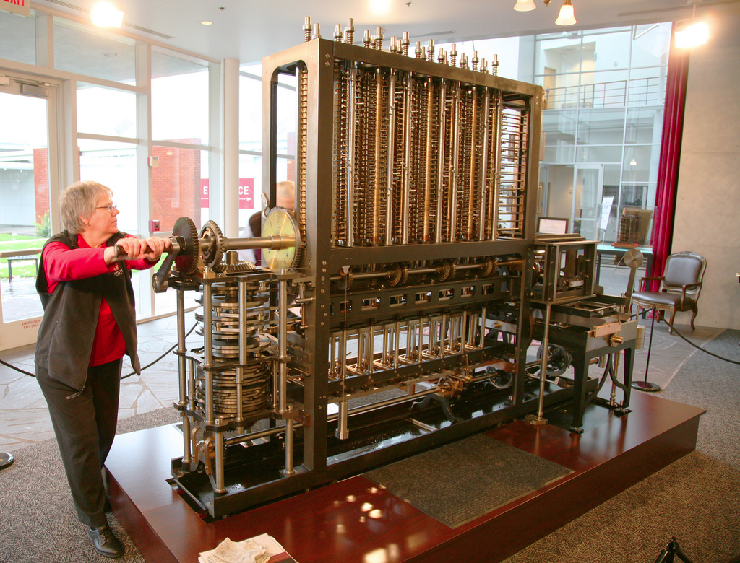
Charles Babbage's Difference Engine No. 2 •simpler than his Analytical Engine •8,000 parts •5 tons •11 feet long
Notes:
https://www.techrepublic.com/pictures/babbages-difference-engine-and-other-historic-computers/
http://www.computerhistory.org/babbage/
Charles Babbage (1791-1871), considered computer pioneer, designed the first automatic computing engines but they were too complex to build. The first complete Babbage Engine was completed in London in 2002, 153 years after it was designed.
Difference Engine No. 2, a calculator, built faithfully to the original drawings, consists of 8,000 parts, weighs five tons, and measures 11 feet long.
Babbage's more complex Analytical Engine has never been built.

Slide 13
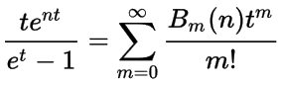
Short history of Programming Languages
First computer program written by Ada Lovelace in 1842 to calculate a sequence of Bernoulli numbers on Charles Babbage’s Analytical Engine.
See Note G in "Sketch of The Analytical Engine, with notes upon the Memoir by the Translator". Switzerland

Slide 14
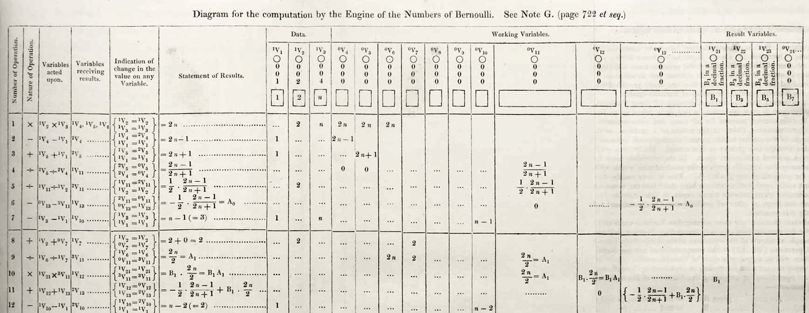
The first program
Number of Operation | Nature of Operation | Variables acted upon | Variables receiving results | Indication of change on the value of any Variable | Statement of Results | Data | Working Variables | Result Variables
Notes:
https://en.wikipedia.org/wiki/Ada_Lovelace#/media/File:Diagram_for_the_computation_of_Bernoulli_numbers.jpg
Column titles shown in highlighted row. Sounds like elements of a program, doesn’t it?

Slide 15
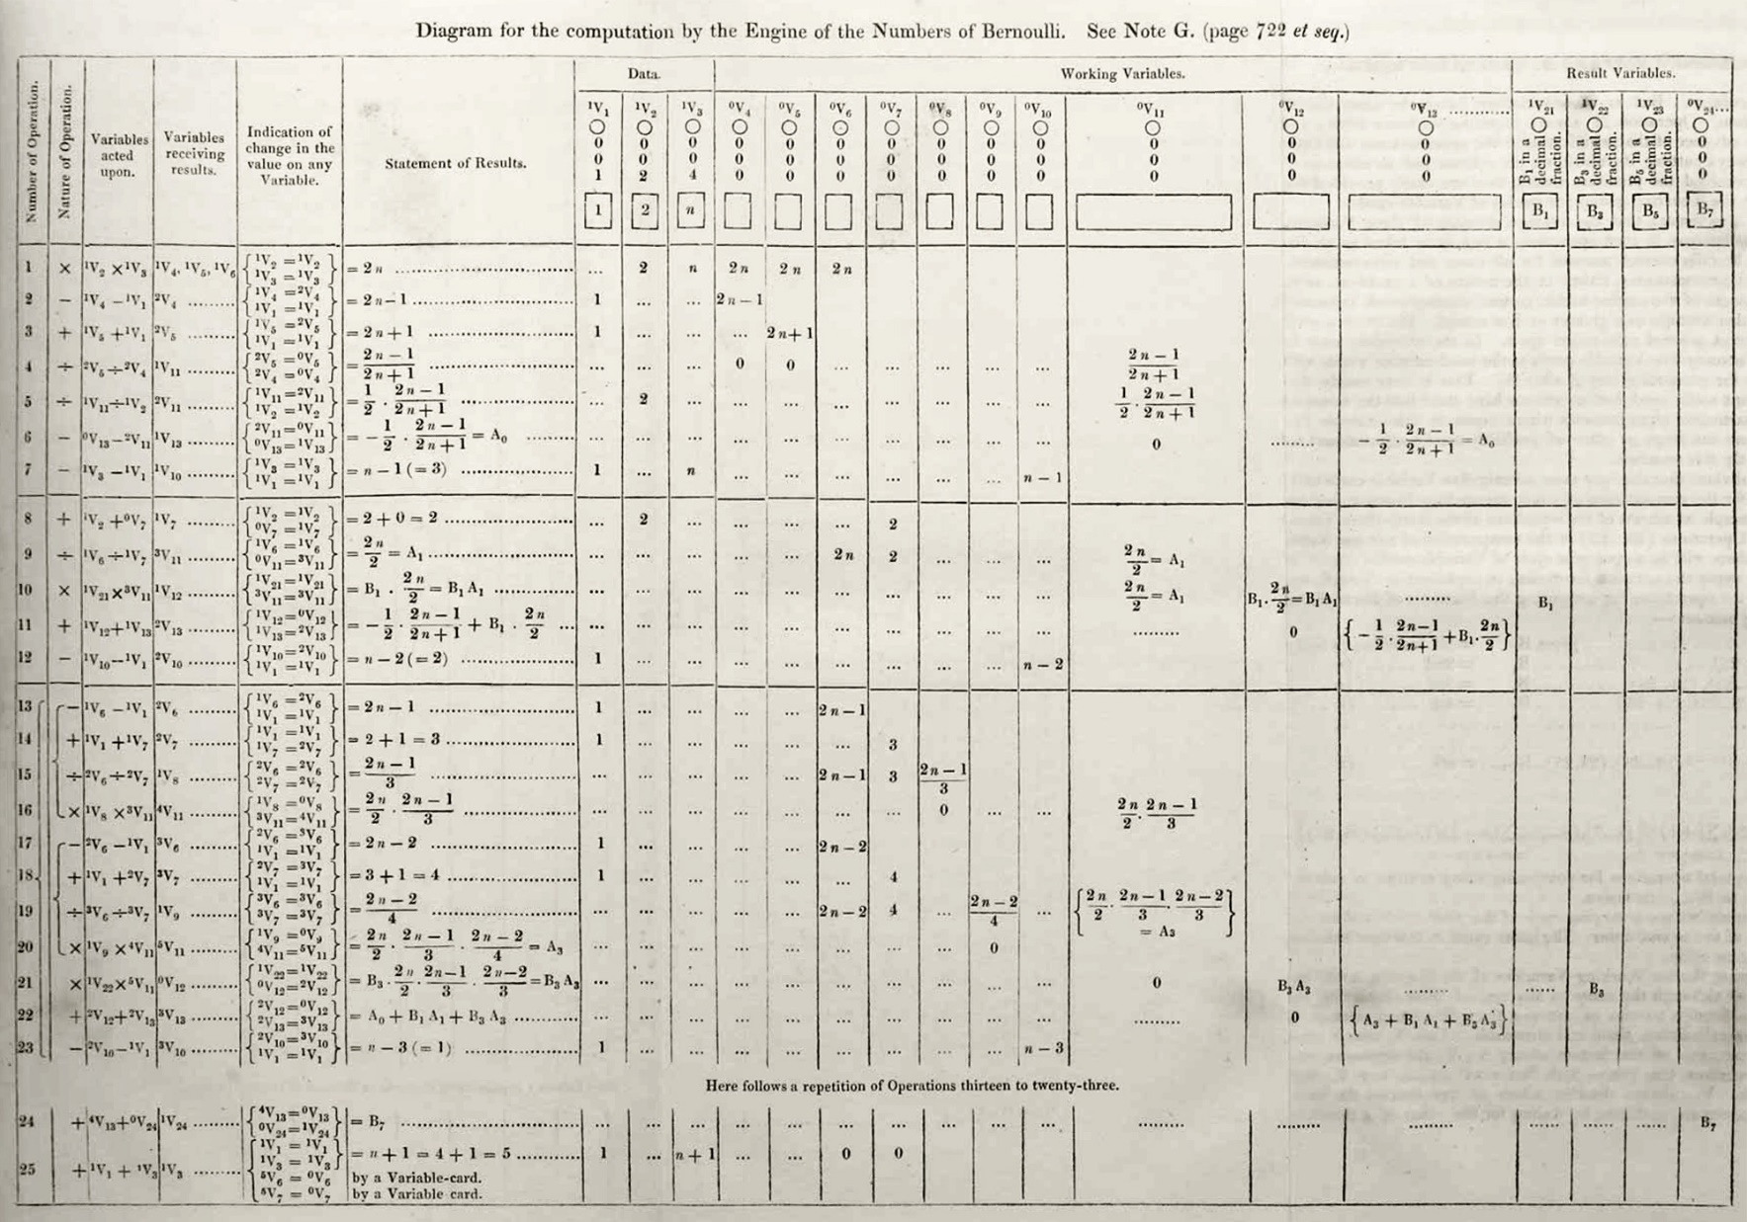
Number of Operation: Sequential Logic put on socks then shoes
Indication of change in value: Conditional Logic IF weather = cold THEN wear boots
Here follows a repetition of Operations 13 – 25: Iteration Logic FOR EACH side (Left, Right) put foot into shoe
Notes:
Control Structures (Böhm-Jacopini theorem, 1966)
There are three kinds of programming logic: Sequence, Selection, and Iteration.
Sequence: It is best to put your socks on before your shoes.
Selection (Conditional): the weather determines the type of footwear
Iteration: For each of Left & Right, put foot into shoe.
Sequential logic
"Life is just one damn thing after another." -- Mark Twain
do this, and then do that, and then do …
Conditional (Selection or Decision) logic
"Damned if you do, damned if you don't" -- Lorenzo Dow
Either do this OR do that.
Iterative (Looping or Repeating) logic
"It is not true that life is one damn thing after another. It's one damn thing over and over." -- Edna St. Vincent Millay
Endless Loop: n., see Loop, Endless. Loop, Endless: n., see Endless Loop.

Slide 16
With logic, comes bugs.
The operators of the Mark II Aiken Relay Calculator put out the word that they had “debugged” the machine.
Notes:
https://www.wired.com/2013/12/googles-doodle-honors-grace-hopper-and-entomology/
Note in logbook of a Grace Hopper project:
“Moth found trapped between points at Relay # 70, Panel F, of the Mark II Aiken Relay Calculator while it was being tested at Harvard University, 9 September 1947. The operators affixed the moth to the computer log, with the entry: “First actual case of bug being found”. They put out the word that they had “debugged” the machine. In 1988, the log, with the moth still taped by the entry, was in the Naval Surface Warfare Center Computer Museum at Dahlgren, Virginia. Image ©Courtesy of the Naval Surface Warfare Center, Dahlgren, VA., 1988. NHHC Collection
“The OED Supplement records sense (4b) of the noun bug (“a defect or fault in a machine, plan, or the like”) as early as 1889. In that year the Pall Mall Gazette reported (11 Mar: 1) that ‘Mr. Edison … had been up the two previous nights discovering a ‘bug’ in his phonograph–an expression for solving a difficulty, and implying that some imaginary insect has secreted itself inside and is causing all the trouble.’….
This meaning was common enough by 1934 to be recognized in Webster’s New International Dictionary: ‘bug, n…. 3. A defect in apparatus or its operation… Slang, U.S.’” (citation)
So, the “actual bug” notation in the lab notebook above probably reflects the amusement of the technician at finding a physical bug, when the word bug was already in use as slang for a problem.
It does appear that the term “debugging” came into use around Hopper’s time period.

Slide 17
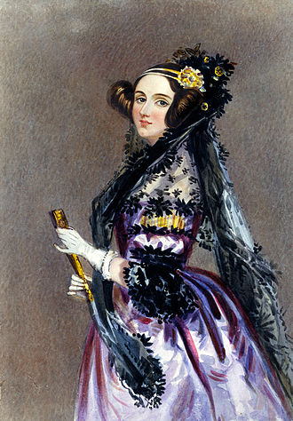
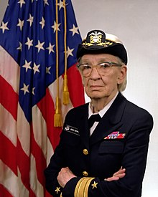
Ada Lovelace Grace Hopper 1815 – 1852 1906 -- 1992
Computing Pioneers
Notes:
https://en.wikipedia.org/wiki/List_of_pioneers_in_computer_science
Jay Elliot described Grace Hopper as appearing to be "'all Navy', but when you reach inside, you find a 'Pirate' dying to be released".
"It’s much easier for most people to write an English statement than it is to use symbols. So I decided data processors [programmers] ought to be able to write their programs in English, and the computers would translate them into machine code. [She invented the first compilers and machine-independent programming languages in 1952 – 1954] That was the beginning of COBOL, a computer language for data processors. I could say “Subtract income tax from pay” instead of trying to write that in octal code or using all kinds of symbols. "
"The most important thing I've accomplished, other than building the compiler, is training young people. They come to me, you know, and say, 'Do you think we can do this?' I say, "Try it." And I back 'em up. They need that. I keep track of them as they get older and I stir 'em up at intervals so they don't forget to take chances."
We should all be Grace Hoppers.
https://en.wikipedia.org/wiki/Grace_Hopper

Slide 18
Short history of Programming Languages
Early Programming Languages focused on language structure and invented many of the key elements we see today including variables, sorting, constants, procedures, functions, comments.
FORTRAN (1954) FORmula TRANslation
First widely used high-level general purpose programming language
LISP (1958), COBOL (1959)
Both still in use for AI and business respectively
Notes:
Note that "many of the key elements we see today" were invented by Frances Holberton, Jean Bartik (two of the ENIAC 6), and Grace Hopper.
A language is old because it was good enough to get old.
LISP derives from "LISt Processor". Schema and other variants continue in the AI field.
COmmon Business-Oriented Language – The most used language on mainframes.
In 1997, the Gartner Group reported that 80% of the world's business ran on COBOL with over 200 billion lines of code and 5 billion lines more being written annually.^{[97]}
In 2006 and 2012, Computerworld surveys found that over 60% of organizations used COBOL (more than C++ and Visual Basic .NET) and that for half of those, COBOL was used for the majority of their internal software.

Slide 19
Short history of Programming Languages (Cont’d)
1970s: structured programming with subroutines, code blocks, and control patterns. GOTO was outlawed but it took until the 1980s to go away.
C (Kernighan & Ritchie, 1978. The C Programming Language aka K&R)
The first cross platform systems programming language; created to write UNIX.
1980s: standards, consolidation, modules, performance, RDBMS.
From monolithic C and COBOL to modular and Object Oriented programming
C++ (Bjarne Stroustrup, 1985. The C++ Programming Language)
C with OO improved Systems Programming (OS) & high-performance applications.
Classes unified data & logic into objects that have their own state and behaviour. Objects know things about themselves and can act upon what they know.
Relational Database Management Systems (RDBMS)
SQL (Structured Query Language: data storage & retrieval)
Data could now take care of itself without explicit programming
RDBMS and SQL set up and enforced the rules for data usage which all programs had to obey
Notes:
https://en.wikipedia.org/wiki/History_of_programming_languages
https://en.wikipedia.org/wiki/Structured_programming
GOTO outlawed. As programs using GOTO grew with ongoing maintenance and enhancement, the code became unmaintainable, unreliable spaghetti code. Program flow is conceptually twisted and tangled like a bowl of spaghetti. https://en.wikipedia.org/wiki/Spaghetti_code
The GOTO is "an invitation to make a mess of one's program." Go To Statement Considered Harmful open letter in 1968 by Dutch computer scientist Edsger W. Dijkstra, who coined the term "structured programming". Dijkstra, E. W. (March 1968). "Letters to the editor: go to statement considered harmful". Communications of the ACM. 11 (3): 147–148.
Why is it that women find C to be more attractive than Java? Because C doesn’t treat them like objects.
Women should not be seen as objects. Each woman is in a class of her own.
1980s: Reduced Instruction Set Computing CPUs didn't do less, they did it more simply which improved compiler design and hardware/software performance.
This supported the move from monolithic programming like COBOL and C that did everything in one program to modular and Object Oriented programming …from carving a solid block of stone to building something up from Lego.
Old programming models separated data and logic, fields in data files were defined and accessed directly by a program (no SQL, no Relational DBs with columns of data types and rows of data).
Files existed separately from everything else. Any program could change a file according to it's own rules which were, hopefully, the same rules as in all the other programs.
https://en.wikipedia.org/wiki/Object-oriented_programming
OOP can be used to associate real-world objects and processes
O-O Objects sometimes correspond to things found in the real world.
http://bigthink.com/videos/why-i-created-c ➔ Why I Created C++ by Bjarne Stroustrup
http://www.stroustrup.com/bs_faq.html
"Classes are there to help you organize your code and to reason about your programs. You could roughly equivalently say that classes are there to help you avoid making mistakes and to help you find bugs after you do make a mistake. In this way, classes significantly helps maintenance.
A class is the representation of an idea, a concept, in the code. An object of a class represents a particular example of the idea in the code. Without classes, a reader of the code would have to guess about the relationships among data items and functions - classes make such relationships explicit and "understood" by compilers. With classes, more of the high-level structure of your program is reflected in the code, not just in the comments.
Why is it that women find C to be more attractive than Java? Because C doesn’t treat them like objects.
Women should not be seen as objects. Each woman is in a class of her own.
Object Oriented means "programming using class hierarchies and virtual functions to allow manipulation of objects of a variety of types through well-defined interfaces and to allow a program to be extended incrementally through derivation.
The point about arranging classes into a class hierarchy is to express hierarchical relationships among classes and use those relationships to simplify code. "
SQL: SQL includes data query, data manipulation (insert, update and delete), data definition (schema creation and modification), and data access control.
https://en.wikipedia.org/wiki/SQL https://en.wikipedia.org/wiki/Stored_procedure
“The increasing adoption of stored procedures led to the introduction of procedural elements to the SQL language in the SQL:1999 and SQL:2003 standards in the part SQL/PSM. That made SQL an imperative programming language. Most database systems offer proprietary and vendor-specific extensions, exceeding SQL/PSM. A standard specification for Java stored procedures exists as well as SQL/JRT.”
https://msdn.microsoft.com/en-us/library/ms178642.aspx
https://www.ibm.com/support/knowledgecenter/beta/SSEPEK_10.0.0/apsg/src/tpc/db2z_storedprocedure.html
`

Slide 20
Short history of Programming Languages (Cont’d)
1990s: GUIs & event driven programming, the rise of the Internet
move to object-oriented paradigm
development of interpreted/scripting languages
Visual Basic (1991)
Object-oriented approach with GUI development tool and UI objects
Python (1991)
interpreted, designed for code readability, scalable to large & small systems
Open Source community-based development for CPython, the reference lang.
Java and JavaScript (1995)
Both derived from C++ but not related languages. Java is a programming language mostly server side, JavaScript is a client side (browser) scripting language.
PHP (1995) PHP: Hypertext Preprocessor
popular web server side scripting language interfaces with DB to create dynamic web sites
Notes:
JavaScript drove everyone crazy for the first 10 years of its life because its implementation was not standardized in browsers. What worked in Microsoft’s I.E. did not work in Netscape, etc. Now, with standardization (ECMAScript, 5th Edition in 2008, now in 7th Ed.), JavaScript is a key tool of web development.
Visual Basic had the same problem across versions. Every time Microsoft upgraded it to a new version, they broke old code by changing commands and structures.
http://web.eecs.utk.edu/~huangj/CS302S04/notes/oo-intro.html
PHP (recursive acronym for PHP: Hypertext Preprocessor)

Slide 21
Short history of Programming Languages (Cont’d)
2000s: Object Oriented Programming is now mainstream
C# (2001)
Inherits from Java and C++, uses Microsoft .NET framework
Windows PowerShell (2006)
Object based command line and scripting language, specifically for maintaining Microsoft Windows systems
See TIOBE, PYPL for language popularity; see this for efficiency
2010s: mobile and tablets, non-SQL databases, security by design (Rust), parallel programming (GPUs), distributed processing (blockchain), quantum computing (primary research)
Notes:
What is the object oriented way to become wealthy? Inheritance. (It will be funnier next term in C++ classes.)
Both Concurrent and Parallel programming have different, independent execution paths, known as threads or modules, that (appear to) run at the same time.
Concurrent execution is possible on single processor (multiple threads, managed by scheduler, run asynchronously)
Parallel execution runs multiple threads simultaneously on multiple processors. (One thread per many CPU/GPU processors)
Concurrent execution is the generalized form of parallel execution. Parallel programs are concurrent but concurrent programs are not necessarily parallel.
Concurrency means that two or more calculations happen within the same time frame, and there is usually some sort of dependency between them.
Parallelism means that two or more calculations happen simultaneously.
Put boldly, concurrency describes a problem (two things need to happen together), while parallelism describes a solution (two processor cores are used to execute two things simultaneously).
Distributed programs = programs working together on multiple, separate systems
https://en.wikipedia.org/wiki/Measuring_programming_language_popularity
Energy Efficiency across Programming Languages
http://greenlab.di.uminho.pt/wp-content/uploads/2017/09/paperSLE.pdf
C is fast, lite, and efficient. Python is a pig.

Slide 22
Levels and Types of Programming Languages
Low vs High level
Compiled vs Hybrid vs Interpreted
General purpose vs embedded or data centric

Slide 23
High vs Low Level Programming Languages
Platform = OS + hardware
Low-Level: run on the hardware, the "bare metal".
operating systems and device drivers programmed for the specific hardware. e.g. Assembler, C, C++ run on x86 architecture
High-Level: use the services of Low-Level code allowing programming to be independent of underlying hardware.
e.g. user-facing applications which run on the OS. C++ for high performance games. Python for general purpose.
Audio/Visual Learning: https://www.lynda.com/Programming-Foundations-tutorials/What-programming-language/83603/90431-4.html
Notes:
C++ Instructor: “Those darn students keep asking us to teach low-level languages.” C Instructor: “So?” C++ Instructor: “So… if I told them once, I’ve told them a thousand times: There are no classes in C”
platform = OS + hardware
https://en.wikipedia.org/wiki/Computing_platform
The term "low-level" may seem a bit disparaging, but -- in computer science -- it actually refers to a programming language that provides little or no abstraction from a computer's underlying hardware architecture. By comparison, Python is often said to be a high-level language, which means that it is abstracted from the nitty-gritty details of the underlying system. (https://www.embedded.com/electronics-blogs/max-unleashed-and-unfettered/4441623/Python-is-better-than-C---Or-is-it-the-other-way-round-)

Slide 24
Types of Programming Languages
Compiled Languages: translators generate machine code from source code before a program can be run. E.g. C, C++, and Objective-C are compiled. Fast but less flexible than interpreted languages. Variables statically typed: data types declared by programmer.
Hybrid Languages: first compiled into platform-neutral bytecode and then interpreted by a virtual machine on local platform. E.g. Java, C#, and Python.
Notes:
Java: Write Once, Run Anywhere. The Bytecode is generic Java. The JVM – Java Virtual Machine – is unique to each platform (hardware & OS). The JVM reads generic bytecode and translates those instructions into platform specific machine code that executes. Numerous JVMs optimize the bytecode (e.g. Just-In-Time compilers) for performance near to compiled languages but much faster than interpreted languages.
Variables statically typed at compile time: It allows static (without running the program) detection of many programming errors quickly, reliably and automatically.
It prevents run-time errors such as “cannot concatenate string + numeric values”. It also increases speed of execution. The system never has to think, “Now what kind of value is in this variable and can it be used the way the program has specified?” Neither does the programmer have to remember—for sure—when writing the code; if the programmer forgets, the compiler will catch the error. In the case of a type error with interpreted code, the user catches the error.

Slide 25
Types of Programming Languages
Interpreted/Scripting Languages: line-by-line executors of source code. Not compiled. Little pre-runtime translation. Slower but flexible and reactive. Variables dynamically typed at run time.
Command Language Interpreter (CLI) (or a shell that runs scripts) MS-PowerShell & *nix Bash are examples.
Data-Oriented Languages (like SQL) designed for management of data in relational databases. SQL with its stored procedures is not a general purpose programming language; SQL is RDBMS specific.
Embeddable Languages are designed to be embedded within other text or content, such as a web page. Web servers process script commands (PHP) embedded in a dynamic HTML file before generated HTML is sent to client (browser). On the browser, JavaScript runs from inside the HTML.
Notes:
Interpreted Languages do not require compilation before being run. Some OS have local optimizations to improve performance especially for JavaScript.
Interpreted languages are "dynamically typed" which means that variables and values are classified into types (alpha or numeric) at run time. This is part of their flexibility.
Command Language Interpreter (CLI) is often confounded with CLI (command line interface). The latter is just a text-based terminal prompt >
if you’re serious about being a sysadmin, you don’t spend your day clicking things in a GUI, you run your network from a command line.
Used for system and job task automation.
SQL is a domain specific language, that being databases. SQL is a declarative languages in which you tell the computer what to do, not how. E.g. create a Table with these Columns… The DB itself has its own internal code that determines exactly how it is done.
<!DOCTYPE HTML>
<html>
<head>
<title>Embedded scripting examples</title>
</head>
<body>
<!–– PHP script in an HTML file ––>
<?php
echo "Hi, I'm a PHP script!";
?>
<!–– JavaScript in an HTML file ––>
<script>
alert( 'Hello, world!' );
</script>
</body>
</html>

Slide 26
Types of Programming Languages (Cont’d)
Audio/Visual Learning: compiled vs interpreted languages https://www.lynda.com/Programming-Foundations-tutorials/Compiled-interpreted-languages/83603/90433-4.html
Dan Bricklin, how he invented the first “killer app” https://www.youtube.com/watch?v=ORvwzo-f1Sc&ab_channel=TEDxTalks
https://en.wikipedia.org/wiki/Killer_application
Notes:
Dan Bricklin offers a brief history of computers from the programmer’s POV. He also tells his process of creating VisiCalc, the world’s first “Killer App” which is
“any computer program that is so necessary or desirable that it proves the core value of some larger technology, such as computer hardware,
In other words, consumers would buy the (usually expensive) hardware just to run that application.”

Slide 27
Types of Non-Programming Languages
“Languages” which are not programming languages:
HTML: HyperText Markup Language for the Web
CSS: Cascading Style Sheets separate presentation (font, size, colours for a Paragraph) from content (HTML <P> which locates text on the page)
XML: eXtensible Markup Language
Document and data encoding markup language
E.g. for data structures used in web services
Notes:
Plain text <tagged> scripts that describe data and presentation.

Slide 28
Glossary of Hardware Devices
Computer hardware is what you can physically touch. Hardware devices are physical parts of a computer system.
Some hardware devices are residing inside the computer case like Motherboard and NIC. But some, are called Peripheral Devices which connect to a computer system and add some functionality to it (like Mouse and Keyboard.)
Some hardware devices are Processing hardware devices like CPU, ALU, and GPU. Some, are Input devices like Keyboard, Mic, Mouse, Digital Pen, and Scanner. Some are Output devices like Monitor, Printer, Speaker, and Plotter. And some could be considered Input and Output at the same time like HDD, CD/DVD Drive, Touch Screen, RAM, USB, Memory Card, HDMI, and VGA Connector.
Notes:
For those who do care about the hardware inside the case, here are a few of the bits and pieces.

Slide 29
Glossary: what do we mean by Algorithm, Code, and Programming?
Computer Programming: a process that leads from an original formulation of a problem to executable computer programs.
Algorithm: a self-contained step-by-step set of operations that solve a problem.
Code: a set of instructions programmed into a computer to perform an Algorithm.
Computer Program: sets of code that tell a computer what to do, written in one or more Programming Languages, contained as a Source Code in a text file, compiled into Machine Code, and executed by CPU.

